Slide 1

Email spam detection
Exploring Techniques for Efficient Spam Detection in Emails using Machine Learning
By Harsh Mishra

Slide 2
Introduction
Project Title: Email Spam Detection
Objective: To develop an accurate model using Python, NLP and machine learning to identify spam emails, ensuring accurate email classification based on text data.
Importance: Enhance user experience and security by filtering unwanted and potentially harmful emails, separating genuine messages from spam.
Technologies Used: Python, NLP Techniques, Machine Learning Algorithm,, NumPy, and pandas.

Slide 3


Our AIM
Libraries and Tools
Overview of Data
Data Preprocessing
Data Splitting
NLP Techniques
Machine Learning Models
Cross Validation
Conclusion

Slide 4
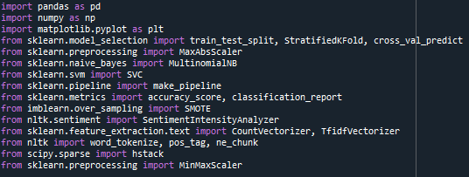
Libraries and Tools
These libraries and tools collectively enable data preprocessing, model building, training, and evaluation.
Libraries Used:
pandas: Data manipulation and analysis library.
numpy: Numerical computing library for arrays.
matplotlib: Plotting and data visualization library.
sklearn.model_selection: Splitting data and cross-validation tools.
sklearn.preprocessing: Data scaling and transformation tools.
sklearn.naive_bayes: Naive Bayes classification algorithm.
sklearn.svm: Support Vector Machines for classification.
sklearn.pipeline: Constructing machine learning pipelines.
sklearn.metrics: Evaluation metrics for model performance.
imblearn.over_sampling: Oversampling for handling class imbalance.
nltk.sentiment: Sentiment analysis tools using NLTK.
sklearn.feature_extraction.text: Text vectorization methods.
nltk: Natural Language Toolkit for text processing.
scipy.sparse: Sparse matrix handling in SciPy.
Key Tools :
Jupyter Notebook: Development and testing of code.
python: Core programming language for the project..
scikit-learn: Machine learning library for model evaluation and metrics.

Slide 5
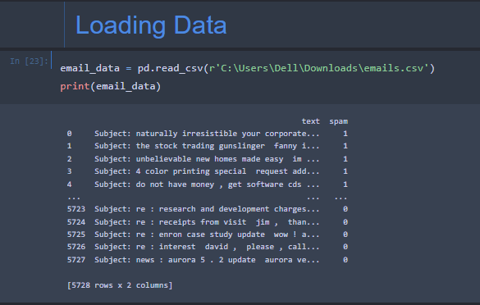
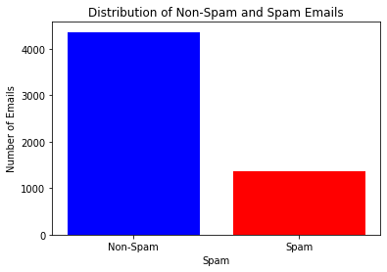
Overview of Data
Data loading and preprocessing are crucial steps to ensure data quality and model compatibility.
Data Loading:
Utilized pandas to load and manipulate dataset.
In this dataset there is no missing values.

Slide 6

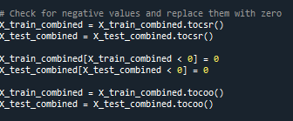
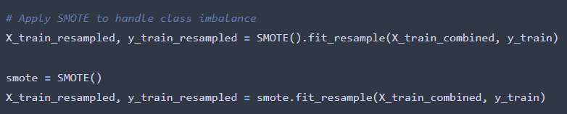
Data Preprocessing
Creating the depended and Independent value from the given data.
Negative Value Replacement
Addressing negative values in features
Transformation using zero replacement for enhanced compatibility
Ensuring consistency in feature representation
Handling Class Imbalance with SMOTE
Dealing with imbalanced data distribution
Synthetic Minority Over-sampling Technique (SMOTE) application
Balancing classes to improve model performance

Slide 7
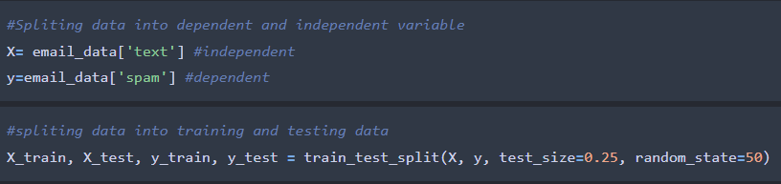
Data Splitting
Data splitting ensures a separate dataset for model training and evaluation, preventing overfitting
Train-Test Split:
Split the dataset into training and testing subsets.
Used sklearn's train_test_split function.
Common practice: 75% training, 25% testing.

Slide 8

NLP Techniques
Sentiment Analysis:
It is used to determine the sentiment expressed in a piece of text.
Text Tokenization and Vectorization:
Tokenization is the process of breaking down a piece of text into smaller units, known as tokens.
Machine learning models require numerical input, so text data needs to be converted into a numerical format
Named Entity Recognition (NER):
is a subtask of natural language processing (NLP) that focuses on identifying and classifying entities (such as names of people, organizations, locations, dates) within a text.
Word Embeddings
Word Embeddings are vector representations of words in a continuous vector space, capturing semantic relationships between words.

Slide 9
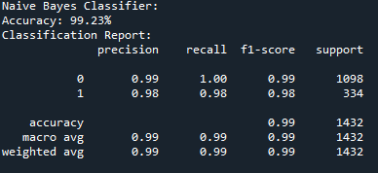
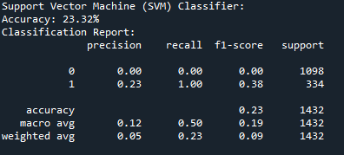
Machine Learning Algorithms
Naive Bayes classifier
After applying NB Classifier and model Evaluation we find our model accuracy is 99.23%.
Support Vector Machine (SVM)
After applying SVM Classifier and model Evaluation we find our model accuracy is 23.32%. Which is very low.

Slide 10
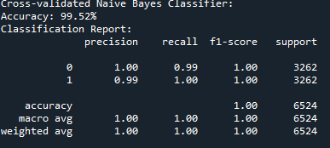
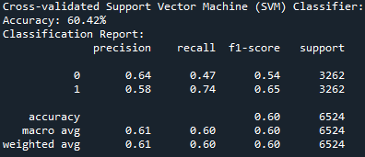
Cross validation
For enhance the performance of a our model and addressing potential issues such as overfitting or underfitting we use cross validation. And after applying we find that our model performance increases
NB classifier accuracy with cross validation- 99.52%
SVM classifier accuracy with cross validation- 60.42%

Slide 11
Conclusion
The project successfully implemented various NLP techniques and machine learning algorithms to classify emails as spam or non-spam.
The models demonstrated reasonable accuracy, and the cross-validation results provided insights into their robustness.
Continued refinement and monitoring are essential for maintaining the model's effectiveness over time.

Slide 12
Thank You !

